Slide 1
THE PERIODONTAL POCKET
GUIDED BY: PRESENTED BY: DR.P.SURESH, K.LATHA, PROF & HOD, PG STUDENT. DEPARTMENT OF PERIODONTICS.

Slide 2
CONTENTS
INTRODUCTION
DEFINITION
CLASSIFICATION
CLINICAL FEATURES
DETECTION OF PERIODONTAL POCKET
DIAGNOSIS WITH THE AVAILABLE CHAIR-SIDE PROBING TOOLS
PATHOGENESIS
HISTOPATHOLOGY
MICROBIAL COLONIZATION AND PERIODONTAL POCKET FORMATION
BACTERIAL INVASION
MECHANISM OF TISSUE DESTRUCTION

Slide 3
MICROTOPOGRAFY OF GINGIVAL WALL
PERIODONTAL POCKETS AS HEALING LESIONS
POCKET CONTENTS
ROOT SURFACE WALL
DECALCIFICATION AND REMINERALIZATION OF CEMENTUM
SURFACE MORPHOLOGY OF TOOTH WALL
PERIODONTAL DISEASE ACTIVITY
PERIODONTAL DISEASE EVALUATION SYSTEM
SITE SPECIFICITY
PULP CHANGES ASSOCIATED WITH PERIODONTAL POCKETS

Slide 4
RELATIONSHIP OF ATTACHMENT LOSS AND BONE LOSS TO POCKET DEPTH
AREA BETWEEN BASE OF POCKET AND ALVEOLAR BONE
POCKET REDUCTION SURGERIES
TREATMENT OF PERI-IMPLANT POCKETS DIAGNOSED WITH PERI-IMPLANT MUCOSITIS
TREATMENT OF PERI-IMPLANT POCKETS DIAGNOSED WITH PERI-IMPLANTITIS
SELF-PERFORMED DIRECT BIOFILM MANAGEMENT OF POCKETS
RELATIONSHIP OF POCKET TO BONE
REFERENCES

Slide 5
INTRODUCTION
Unique anatomical structure.
During developmental process
Normal sulcus.
Dynamic balance.
Degenerative changes.

Slide 6
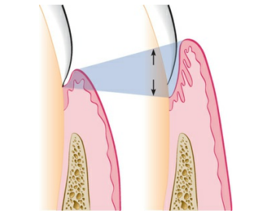
Definition
The periodontal pocket, which is defined as a pathologically deepened gingival sulcus, is one of the most important clinical features of periodontal disease.
Accordingly, the space between the pathologically detached gingiva and the tooth is called a pocket.

Slide 7
CLASSIFICATION
Deepening of the gingival sulcus may occur as a result of coronal movement of the gingival margin, apical displacement of the gingival attachment, or a combination of the two processes.
Pockets can be classified as follows:
Gingival pocket (also called “peudo-pocket”) is formed by gingival enlargement without destruction of the underlying periodontal tissues. The sulcus is deepened because of the increased bulk of the gingiva.
Periodontal pocket produces destruction of the supporting periodontal tissues, leading to the loosening and exfoliation of the teeth.

Slide 8
Based on the location of the base of the pocket in relation to the underlying bone, periodontal pockets can be classified into the following types:
• Suprabony (supracrestal or supraalveolar) occurs when the bottom of the pocket is coronal to the underlying alveolar bone.
• Intrabony (infrabony, subcrestal, or intraalveolar) occurs when the bottom of the pocket is apical to the level of the adjacent alveolar bone.
With this second type, the lateral pocket wall lies between the tooth surface and the alveolar bone.

Slide 9
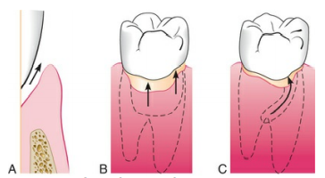
Pockets can involve one, two, or more tooth surfaces, and they can be of different depths and types on different surfaces of the same tooth and on approximal surfaces of the same interdental space.
Pockets can also be spiral (i.e., originating on one tooth surface and twisting around the tooth to involve one or more additional surfaces). These types of pockets are most common in furcation areas.

Slide 10
Clinical features
Clinical signs
include a bluish red thickened marginal gingiva,
a bluish red vertical zone from the gingival margin to the alveolar mucosa,
gingival bleeding and
suppuration,
tooth mobility,
diastema formation, and
symptoms such as localized pain or pain “deep in the bone.”
The only reliable method of locating periodontal pockets and determining their extent is careful probing of the gingival margin along each tooth surface.

Slide 11
On the basis of depth alone, however, it is sometimes difficult to differentiate between a deep normal sulcus and a shallow periodontal pocket.
In such borderline cases, pathologic changes in the gingiva distinguish the two conditions.

Slide 12
Correlation of clinical and histopathologic features of the periodontal pocket
CLINICAL FEATURES | HISTOPATHOLOGIC FEATURES
The gingival wall of the pocket presents various degrees of bluish red discoloration; flaccidity; a smooth, shiny surface; and pitting on pressure. | The discoloration is caused by circulatory stagnation; the flaccidity by the destruction of gingival fibers and surrounding tissues; the smooth, shiny surface by atrophy of the epithelium and edema; and the pitting on pressure by edema and degeneration.
Less frequently, the gingival wall may be pink and firm. | In such cases, fibrotic changes predominate over exudation and degeneration, particularly the outer surface of the pocket wall. However, the inner wall of the pocket invariably presents some degeneration and is often ulcerated.
Bleeding is elicited by gently probing the soft-tissue wall of the pocket. | Ease of bleeding results from increased vascularity, the thinning and degeneration of the epithelium, and the proximity of engorged vessels to the inner surface.
When explored with a probe, the inner aspect of the pocket is generally painful. | Pain on tactile stimulation is caused by the ulceration of the inner aspect of the pocket wall.
In many cases, pus may be expressed with the application of digital pressure. | Pus occurs in pockets with suppurative inflammation of the inner wall.

Slide 13
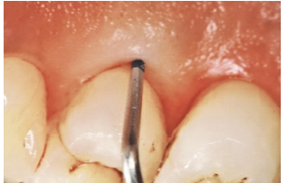
DETECTION OF PERIODONTAL POCKET
The only accurate method of detecting and measuring periodontal pockets is careful exploration with a periodontal probe.
Pockets are not detected by radiographic examination.
The periodontal pocket is a soft-tissue change.
Radiographs - they show no difference before and after pocket elimination unless bone has been modified.

Slide 14
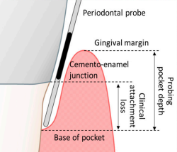
Gutta-percha points or calibrated silver points can be used with the radiograph to assist with determining the level of attachment of the periodontal pockets.
They may be used effectively for individual pockets or in clinical research, but their routine use throughout the mouth would be difficult to manage.
Clinical examination and probing are more direct and efficient.

Slide 15
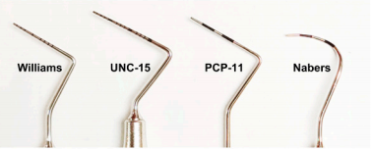
Diagnosis with the Available Chair-side Probing Tools
There are many types of commercially available periodontal probes; however, manual probes remain the gold standard in dental clinics for measuring CAL and PD.
The manual probes consist of a handgrip and probe tip.
The tip design can range in length (12–16.5 mm in length), thin (0.4~0.6 mm diameter), and shape of the working end (spherical end, domed end, and a flat end with rounded corners) that can be inserted into the base of the pocket.

Slide 16
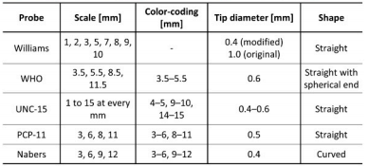
In addition, various types of probe with colors of graduated scales are displayed on the probe tip surface to help the manual reading of CAL and PD in millimeters.
For standardization of the probe, a general requirement for manual stainless-steel periodontal probes was specified by the International Organization for Standardization (ISO 21672-1 and -2:2012).
However, even with these standardizations and specialized training, manual periodontal probe measurements can vary significantly due to inter-examiner differences in the probing force, probing angle, reading variations when reading manual scales, clinician proficiency, and the unpredictable anatomy of periodontal pockets, especially as the disease progresses.

Slide 17
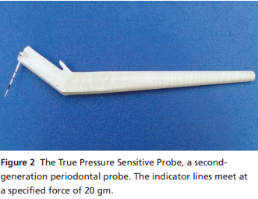
Several types of probes were made to minimize inconsistencies – like the force-controlled probes were designed to reduce the variation in probing forces by clinicians.
0.20 N – 0.25 N, allowing accurate diagnosis and minimizing patient discomfort.
The True Pressure Sensitive probe (TPS probe, Ivoclar Vivadent, Schaan, Liechtenstein) and Pro-DenRx Sensor Probe (Den-Mat Holdings, Lompoc, CA, USA).
Operated manually, but maintain constant force without electronic control.
TPS – visual guidance.

Slide 18
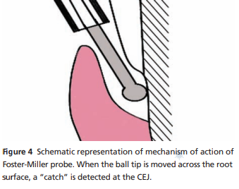
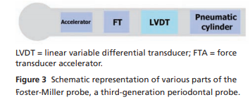
Electronic force controlled probe with visual guidance – introduced by Polson in 1980.
Polson’s probe was developed into Yeaple probe – dentinal hypersensitivity.
The computerized periodontal system was used to record probing depths with 0.2 mm precision and automatically transferred to computer chart.
The Florida Probe, InterProbe and the pa-on Parometer- computerized.
The Foster-Miller probe – automatic PD and CAL measurement by detecting CEJ for CAL measurement.

Slide 19
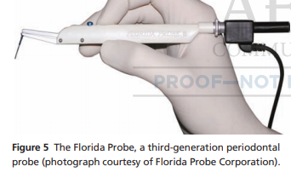
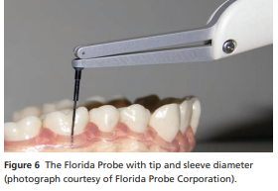
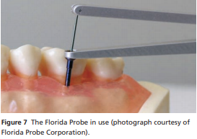

Slide 20
PATHOGENESIS
In a clinically healthy situation, there is a shallow gingival sulcus around teeth.
Histologically, the gingival sulcus is lined by the sulcular epithelium, the coronal end of the junctional epithelium at the sulcus bottom and the tooth surface.
The sulcular epithelium is structurally different from and less permeable than the junctional epithelium.
The free surface of the JE is very permeable, allowing fluid and cells to leave the JE enter the oral cavity, thereby ensuring normal defense mechanisms against constantly present microorganisms and their products.

Slide 21
This open system, which lacks a physical barrier in the form of a keratinized cell layer, may, however, allow microorganisms and their products to invade the JE.
Normally, the JE masters this difficult task as a result of its very sophisticated structural and functional properties that provide potent antimicrobial mechanisms.
In this defense system, the JE provides a structural framework through which mainly neutrophils migrate to reach the sulcus bottom.
These transmigrating neutrophils provide the first line of defense around teeth.

Slide 22
The nature of the dento–gingival junction is very heterogeneous and consists of:
cell attachment to the tooth surface via hemidesmosomes and basal lamina;
cell-to-cell attachment within the junctional epithelium, primarily via desmosomes (maculae adherentes); and
attachment to the surrounding gingival connective tissue via a basement membrane. Epithelial cell attachment to the tooth surface is first established by ameloblasts and later maintained by the innermost cells of the junctional epithelium.

Slide 23
The epithelial attachment mechanism is considered to be of high strength.
Of equal importance are the cell-to-cell contacts connecting neighboring epithelial cells.
In fact, intact cell-to-cell connectivity is an absolute requirement for the correct functioning of cells, tissues and entire organisms.
Cell-to-cell adherence and communication between cells is mediated by the so-called intercellular junction complexes consisting of desmosomes, adherens junctions, tight junctions and gap junctions.

Slide 24
Compared with other types of epithelia, junctional epithelial cells are interconnected by a few desmosmes only and occasional gap junctions.
The low number of desmosomes and wide intercellular spaces enable sulcular fluid and inflammatory and immune cells to transmigrate through the junctional epithelium.

Slide 25
As the conversion of junctional epithelium to pocket epithelium is regarded as a hallmark in the development of periodontitis, the potential factors contributing to the initiation of pocket formation need to be critically analyzed.
Microorganisms are the primary etiologic cause of periodontal disease and there is good evidence that pocket formation is related to bacterial colonization of the subgingival tooth surface. Nevertheless, there is a lack of experiments evaluating the mechanisms of pocket formation.
Previous discussions on the initiation of pocket development centered around whether:
the epithelial cells first recede and later, as a consequence of this, biofilm can migrate apically; or
bacterial products force the epithelial cells to migrate apically.

Slide 26
Degenerative changes, such as loss of cellular continuity and detachment from the tooth, are first observed in the coronal-most portion of the JE (i.e. at the sulcus bottom).
Whether detachment of junctional epithelial cells from the tooth surface or destruction of cell junctional complexes is more important for pocket development remains unclear.
However, the important question is why does loss of cellular continuity, and thus loss of structural integrity, occur at all at this site?
Are host-derived factors associated with inflammation (such as cytokines) the primary cause or do microbial products directly trigger destruction of the junctional epithelium and thereby destabilize the structure–function relationship?

Slide 27
Several possibilities have been proposed to explain intra-epithelial cleavage in the junctional epithelium.
With increasing degree of inflammation, an increase in both migration of neutrophils and passage of gingival crevicular fluid through the intercellular spaces occurs.
A moderate distension of intercellular spaces is not considered to compromise the structural and functional integrity of the junctional epithelium.
An increased number of leukocytes is, however, considered as a contributing factor that eventually leads to focal disintegration of the JE. This is in line with the concept that the host itself is the driving force behind decomposition of the JE.

Slide 28
Apart from this view, direct influence of bacteria on the breakdown of the coronal portion of the JE has to be taken into consideration.
Indeed, it has been hypothesized that pocket formation results from the subgingival spread of bacteria under impaired defense conditions.
In this context, the cysteine proteinases, referred to as gingipains (namely virulence factors produced by Porphyromonas gingivalis, a species of bacterium implicated as a major etiological agent of chronic periodontitis), have been the focus of intense research.
As a result, a new effect of gingipains was discovered. Gingipains specifically proteolytically degrade components of cell-to-cell junctional complexes in epithelial cells.

Slide 29
In addition, gingipains also cleave intercellular adhesion molecule-1 on oral epithelial cells, which consequently leads to disruption of the interaction between neutrophils and epithelial cells, a sort of immune evasion by P. gingivalis.
Intercellular adhesion molecule-1, also known as CD54, a member of the immunoglobulin superfamily of recognition molecules, mediates cell-to-cell interactions in inflammatory reactions by functioning as a ligand for the b2 integrins present on leukocytes.
And thus has an important function in the control of leukocyte migration to inflammatory sites.

Slide 30
Thus, specific degradation of cell junctional complexes and disturbance of the intercellular adhesion molecule-1-dependent adhesion of neutrophils to epithelial cells through gingipains point to the importance of these virulence factors in the breakdown of the JE, which eventually leads to pocket development.
In an apical direction, the pocket epithelium remains contiguous with a JE of reduced height.
To maintain an epithelial attachment, the residual JE proliferates further apically, as the pocket deepens.

Slide 31
HISTOPATHOLOGY
Histopathologically, a pocket is ‘a pathologically altered gingival sulcus, lined to a variable extent with pocket epithelium’.
It is characterized by marked proliferation of retial ridges around inflamed connective tissue papillae and by a tendency to micro-ulceration’.
The junctional epithelium and pocket epithelium have some features in common, such as formation of a barrier against microorganisms and their products, passage of gingival fluid and leukocytes (in particular neutrophils) and concomitant infiltration with mononuclear leukocytes.

Slide 32
The major differences can be summarized as follows:
definite detachment of JE from the tooth surface and conversion into pocket epithelium, leading to formation of an intraepithelial cleft.
proliferation of epithelial ridges into the inflamed soft connective tissue with very thin regions between these ridges.
focal micro-ulcerations of the epithelial ridges and at the free surface of the pocket epithelium.

Slide 33
increased permeability of the pocket epithelium.
high infiltration, particularly of the epithelial ridges, with lymphocytes, including T- and B-cells and plasma cells.
increased migration of neutrophils through the pocket epithelium.
change in direction of the exudate from apico-coronal to horizontal (i.e. toward the tooth root surface).
seamless transition from pocket epithelium to JE at the pocket fundus.
significant reduction in height of the residual JE.

Slide 34
The condition of the soft connective tissue may depend on the severity and duration of the disease.
In the active phase of destruction in which all fibroblasts and collagen fibers around the epithelial ridges are lost and replaced with inflammatory and immune cells.
More peripheral, residual collagen fibers and fibroblasts demarcate the highly infiltrated (former) connective tissue area from healthy tissue.
The morphology of the pocket can vary greatly because extension of the pocket occurs not only by apical deepening but also by widening in a horizontal direction, which leads to undermining pockets.
Pockets also occur in conditions of disease around dental implants.

Slide 35
In recent reviews, it was concluded that peri-implant mucositis and peri-implantitis lesions do not differ fundamentally from gingivitis and periodontitis lesions, respectively, from the perspectives of etiology, pathogenesis, risk assessment, diagnosis and therapy.
However, there appear to be histopathological differences in the host response to infections around implants and teeth in the sense that persistent biofilm may elicit a more pronounced inflammatory response in mucosal tissue around implants than around teeth.
Structural changes (in vascularity and the fibroblast-to collagen ratio) and, consequently, functional disparities may account for this difference.

Slide 36
It is noteworthy that the presence of excess cement at the abutment– crown interface provides an ideal substrate for plaque and calculus deposition and retention and is associated with peri-implant disease.
Overhang at such sites may impede calculus and biofilm removal. It has been shown that clinical and endoscopic signs of peri-implant disease are absent in the majority of cases after excess cement removal.

Slide 37
Microbial colonization and periodontal pocket formation
The postulate that sub-gingival microbial aggregates cause periodontitis is an extrapolation of the finding that bacterial deposits at the gingival crevice cause gingivitis.
As a result of gingival swelling and attachment loss, pocket depth increases and an anaerobic sub-gingival microbiota concomitantly evolves.
It is assumed that gingivitis converts to periodontitis when complex bacterial interactions overload local host resistance.

Slide 38
As the development of a complex subgingival microbiota depends on ecological factors, local environmental changes that favor the growth of pathogens or trigger the expression of virulence factors may be viewed as the underlying cause for periodontal tissue destruction.
Cases of refractory peri-implant infections caused by the persistence of excess luting cement illustrate how mixed anaerobic infections can be triggered and sustained by a foreign body.
Even though bacteria cause suppuration and loss of bone, antimicrobial agents alone cannot resolve these problems.

Slide 39
On the other hand, studies have shown that suspected periodontal pathogens prevail in oral sites other than the periodontal pocket if the micro-environmental conditions are favorable.
For example, in subjects free of periodontal disease, P. intermedia, A, actinomycetemcomitans and other suspected periodontal pathogens were recovered from deep pericoronal sites of third molars under normal eruption.
In another study, in patients treated for cleft lip, alveolus and palate, Fusobacterium spp., and Prevotella spp. were isolated in samples from residual clefts or pronounced soft tissue grooves.

Slide 40
Only a few individual species show a unique association with disease. A. actinomycetemcomitans and P. gingivalis have been suspected to be of particular importance as a result of their pathogenic potential demonstrated in animal models.
A. actinomycetemcomitans displays a broad genetic and phenotypic diversity and is heterogeneously distributed in various populations and cohorts worldwide.

Slide 41
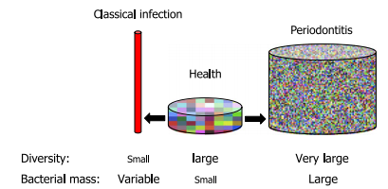
In a prospective study, only one subpopulation of A. actinomycetemcomitans, the ‘JP2 clone’, showed a degree of association that one would expect from a true pathogen.
Although most bacteria are thought to harm tissues only if present in high numbers for prolonged periods of time, but at relatively low number of organisms - strain JP2 may cause damage in susceptible individuals.
In classic bacterial infections the diversity of the microbiota actually decreases as the disease develops, and therefore the causative agent is easily recognizable, for instance Staphylococcus aureus or Pseudomonas aeruginosa in a purulent infection.
In most cases of periodontitis, however, the diversity of the flora increases as the disease develops.

Slide 42
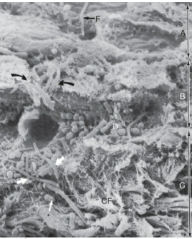
BACTERIAL INVASION
Bacterial invasion of the apical and lateral areas of the pocket wall has been described in human chronic periodontitis.
Filaments, rods, and coccoid organisms with predominant gram-negative cell walls have been found in intercellular spaces of the epithelium.
Hillmann and colleagues have reported the presence of Porphyromonas gingivalis and Prevotella intermedia in the gingiva of aggressive periodontitis cases. Aggregatibacter actinomycetemcomitans has also been found in the tissues.

Slide 43
Bacteria may invade the intercellular space under exfoliating epithelial cells, but they are also found between deeper epithelial cells as well as accumulating on the basement lamina.
Some bacteria traverse the basement lamina and invade the subepithelial connective tissue.
The presence of bacteria in the gingival tissues has been interpreted by different investigators as bacterial invasion or as the “passive translocation” of plaque bacteria.

Slide 44
MECHANISMS OF TISSUE DESTRUCTION
The inflammatory response triggered by bacterial plaque unleashes a complex cascade of events aimed at destroying and removing bacteria, necrotic cells, and deleterious agents.
However, this process is nonspecific; in an attempt to restore health, the host's cells (e.g., neutrophils, macrophages, fibroblasts, epithelial cells) produce proteinases, cytokines, and prostaglandins that can damage or destroy the tissues.

Slide 45
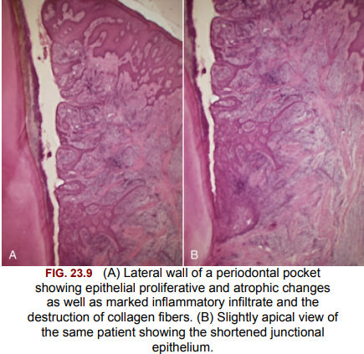
MICROTOPOGRAPHY OF THE GINGIVAL WALL
Scanning electron microscopy has permitted the description of several areas in the soft-tissue (gingival) wall of the periodontal pocket in which different types of activity take place.
These areas are irregularly oval or elongated and adjacent to one another, and they measure about 50 to 200 µm.
These findings suggest that the pocket wall is constantly changing as a result of the interaction between the host and the bacteria.

Slide 46
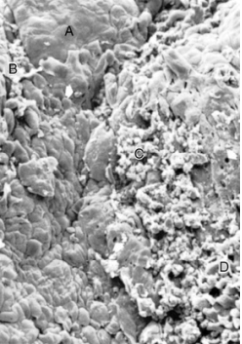
The following areas have been noted:
1. Areas of relative quiescence, showing a relatively flat surface with minor depressions and mounds and occasional shedding of cells.
2. Areas of bacterial accumulation, which appear as depressions on the epithelial surface, with abundant debris and bacterial clumps penetrating into the enlarged intercellular spaces. These bacteria are mainly cocci, rods, and filaments, with a few spirochetes.

Slide 47
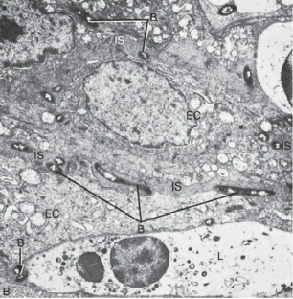
3. Areas of emergence of leukocytes, in which leukocytes appear in the pocket wall through holes located in the intercellular spaces.
4. Areas of leukocyte–bacteria interaction, in which numerous leukocytes are present and covered with bacteria in an apparent process of phagocytosis. Bacterial plaque associated with the epithelium is seen either as an organized matrix covered by a fibrin-like material in contact with the surface of cells or as bacteria penetrating into the intercellular spaces.

Slide 48
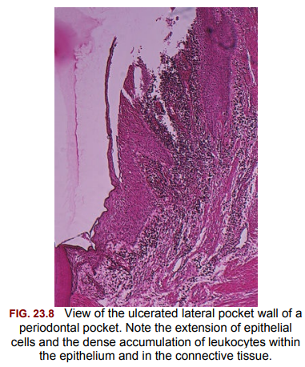
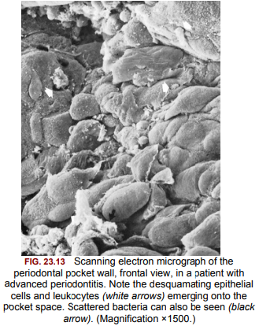
5. Areas of intense epithelial desquamation, consisting of semiattached and folded epithelial squames, which are sometimes partially covered with bacteria.
6. Areas of ulceration, with exposed connective tissue.
7. Areas of hemorrhage, with numerous erythrocytes.
The transition from one area to another could result from bacteria accumulating in previously quiescent areas and triggering the emergence of leukocytes and the leukocyte–bacteria interaction. This would lead to intense epithelial desquamation and finally to ulceration and hemorrhage.

Slide 49
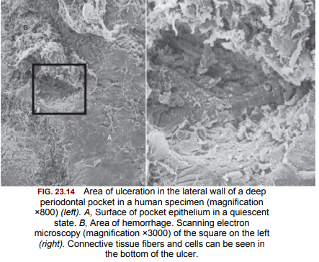

Slide 50
PERIODONTAL POCKETS AS HEALING LESIONS
Periodontal pockets are chronic inflammatory lesions and thus are constantly undergoing repair.
Complete healing does not occur because of the persistence of the bacterial attack, which continues to stimulate an inflammatory response, thereby causing degeneration of the new tissue elements formed during the continuous effort at repair.
The condition of the soft-tissue wall of the periodontal pocket results from the interplay of the destructive and constructive tissue changes.
Their balance determines clinical features such as color, consistency, and surface texture of the pocket wall.

Slide 51
If the inflammatory fluid and cellular exudate predominate, the pocket wall is bluish red, soft, spongy, and friable, with a smooth, shiny surface; at the clinical level, this is generally referred to as an edematous pocket wall.
If there is a relative predominance of newly formed connective tissue cells and fibers, the pocket wall is more firm and pink and clinically referred to as a fibrotic pocket wall.
Edematous and fibrotic pockets represent opposite extremes of the same pathologic process rather than different disease entities.

Slide 52
Fibrotic pocket walls may be misleading, because they do not necessarily reflect what is taking place throughout the pocket wall.
The most severe degenerative changes in periodontal tissues occur adjacent to the tooth surface and the subgingival plaque.
In some cases, inflammation and ulceration on the inside of the pocket are walled off by fibrous tissue on the outer aspect.
Externally the pocket appears pink and fibrotic, despite the inflammatory changes occurring internally.

Slide 53
POCKET CONTENTS
Periodontal pockets contain debris that consists principally of microorganisms and their products (enzymes, endotoxins, and other metabolic products), gingival fluid, food remnants, salivary mucin, desquamated epithelial cells, and leukocytes.
Plaque covered calculus usually projects from the tooth surface.
Purulent exudate, if present in the patient, consists of living, degenerated, and necrotic leukocytes; living and dead bacteria; serum; and a scant amount of fibrin.
The contents of periodontal pockets, when filtered free of organisms and debris, have been demonstrated to be toxic when injected subcutaneously into experimental animals.

Slide 54
Pus is a common feature of periodontal disease, but it is only a secondary sign.
The presence of pus or the ease with which it can be expressed from the pocket merely reflects the nature of the inflammatory changes in the pocket wall.
It is not an indication of the depth of the pocket or the severity of the destruction of the supporting tissues.
Extensive pus formation may occur in shallow pockets, whereas deep pockets may exhibit little or no pus. The localized accumulation of pus constitutes an abscess.

Slide 55
ROOT SURFACE WALLS
The root surface wall of periodontal pockets often undergoes changes that are significant because they may perpetuate the periodontal infection, cause pain, and complicate periodontal treatment.
Pathologic granules have been observed with light and electron microscopy, and they may represent areas of collagen degeneration or areas in which collagen fibrils have not been fully mineralized initially.
In addition, bacterial products (e.g., endotoxin) have also been detected in the cementum wall of periodontal pockets.

Slide 56
When root fragments from teeth with periodontal disease are placed in tissue culture, they induce irreversible morphologic changes in the cells of the culture. Such changes are not produced by normal roots.
Diseased root fragments also prevent the in vitro attachment of human gingival fibroblasts, whereas normal root surfaces allow the cells to attach freely.
When placed in the oral mucosa of the patient, diseased root fragments induce an inflammatory response, even if they have been autoclaved.

Slide 57
These changes manifest clinically as softening of the cementum surface; this is usually asymptomatic, but it can be painful when a probe or explorer penetrates the area.
They also constitute a possible reservoir for reinfection of the area after treatment.
During the course of treatment, these necrotic areas are removed by root planing until a hard, smooth surface is reached.
Cementum is very thin in the cervical areas, and scaling and root planing often remove it entirely, exposing the underlying dentin.
Sensitivity to cold may result until the pulp tissue forms secondary dentin.

Slide 58
DECALCIFICATION AND REMINERALIZATION OF CEMENTUM
Areas of increased mineralization are probably a result of an exchange of minerals and organic components at the cementum– saliva interface after exposure to the oral cavity.
The mineral content of exposed cementum increases, and the minerals that are increased in diseased root surfaces include calcium, magnesium, phosphorus, and fluoride.
Microhardness, however, remains unchanged. The development of a highly mineralized superficial layer may increase the tooth's resistance to decay.
The hyper-mineralized zones are detectable by electron microscopy, and they are associated with increased perfection of the crystal structure and organic changes that are suggestive of a subsurface cuticle.

Slide 59
These zones have also been seen in micro-radiographic studies as a layer that is generally 10 to 20 μm thick, with areas as thick as 50 μm.
No decrease in mineralization was found in deeper areas, indicating that increased mineralization does not come from adjacent areas.
A loss of or reduction in the cross-banding of collagen near the cementum surface and a subsurface condensation of organic material of exogenous origin have also been reported.

Slide 60
Areas of demineralization are often related to root caries.
Exposure to oral fluid and bacterial plaque results in proteolysis of the embedded remnants of Sharpey fibers; the cementum may be softened, and it may undergo fragmentation and cavitation.
Unlike enamel caries, root surface caries tend to progress around rather than into the tooth.
Active root caries lesions appear as well-defined yellowish or light brown areas; they are frequently covered by plaque, and they have a softened or leathery consistency on probing.

Slide 61
Inactive lesions are well-defined darker lesions with a smooth surface and a harder consistency on probing.
The dominant microorganism in root surface caries is Actinomyces viscosus, although its specific role in the development of the lesion has not been established.
Other bacteria, such as Actinomyces naeslundii, Streptococcus mutans, Streptococcus salivarius, Streptococcus sanguinis, and Bacillus cereus, have been found to produce root caries in animal models.
Quirynen and colleagues reported that when plaque levels and pocket depths decrease after periodontal therapy (both nonsurgical and surgical), a shift in oral bacteria occurs, leading to a reduction in periodontal pathogens, an increase in S. mutans, and the development of root caries.

Slide 62
A prevalence rate study of root caries among 20 – 64 year old individuals revealed that 42% had one or more root caries lesions and these lesions tend to increase with age. The tooth may not be painful, but exploration of the root surface reveals the presence of a defect, and penetration of the involved area with a probe causes pain.
Caries of the root may lead to pulpitis, sensitivity to sweets and thermal changes, or severe pain. Pathologic exposure of the pulp occurs in severe cases.
Root caries may be the cause of toothache in patients with periodontal disease and no evidence of coronal decay.
Caries of the cementum requires special attention when the pocket is treated.
The necrotic cementum must be removed by scaling and root planing until firm tooth surface is reached, even if this entails extension into the dentin.

Slide 63
If the root is exposed by progressive pocket formation before repair occurs, these areas appear as isolated cavitations that penetrate into the dentin.
These areas can be differentiated from caries of the cementum by their clear-cut outline and hard surface. They may be sources of considerable pain that require the placement of a restoration.

Slide 64
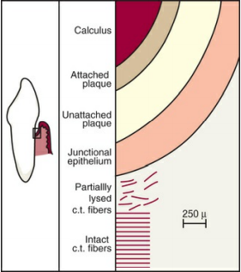
SURFACE MORPHOLOGY OF TOOTH WALL
The following zones can be found in the bottom of a periodontal pocket:
1. Cementum covered by calculus, in which all of the changes described in the above can be found.
2. Attached plaque, which covers calculus and extends apically from it to a variable degree (typically 100 to 500 µm).
3. The zone of unattached plaque that surrounds attached plaque and extends apically to it.

Slide 65
4. The zone of attachment of the junctional epithelium to the tooth. The extension of this zone, which in normal sulci is more than 500 µm, is usually reduced in periodontal pockets to less than 100 µm.
5. A zone of semi destroyed connective tissue fibers may be apical to the junctional epithelium.
Zones 3, 4, and 5 make up the “plaque-free zone” seen in extracted teeth.
The total width of the plaque-free zone varies according to the type of tooth (i.e., it is wider in the molars than in the incisors) and the depth of the pocket (i.e., it is narrower in deeper pockets).
The unattached plaque contains a variety of gram-positive and gram-negative morphotypes, including cocci, rods, filaments, fusiforms, and spirochetes.
The most apical zone contains predominantly gram negative rods and cocci.

Slide 66
PERIODONTAL DISEASE ACTIVITY
According to the recent concept, periodontal pockets go through periods of exacerbation and quiescence as a result of episodic bursts of activity followed by periods of remission.
Periods of quiescence are characterized by a reduced inflammatory response and little or no loss of bone and connective tissue attachment.
A buildup of unattached plaque, with its gram-negative, motile, and anaerobic bacteria , starts a period of exacerbation during which bone and connective tissue attachment are lost and the pocket deepens.

Slide 67
This period may last for days, weeks, or months, and it is eventually followed by a period of remission or quiescence during which gram-positive bacteria proliferate and a more stable condition is established.
On the basis of a study of radioiodine 125 I absorptiometry, McHenry and colleagues confirmed that bone loss in patients with untreated periodontal disease occurs in an episodic manner.
These periods of quiescence and exacerbation are also known as periods of inactivity and periods of activity.

Slide 68
Clinically, active periods show bleeding, either spontaneously or with probing, and greater amounts of gingival exudate.
Histologically, the pocket epithelium appears thin and ulcerated, and an infiltrate composed predominantly of plasma cells, PMNs, or both is seen.
Bacterial samples from the pocket lumen that are analyzed with dark-field microscopy show high proportions of motile organisms and spirochetes.

Slide 69
Periodontal Disease Evaluation System
The Diamond Probe®/Perio 2000® System (Diamond General Development Corp, www.diamondgeneral.com) detects periodontal disease during routine dental examinations by measuring relative sulfide concentrations as an indicator of gram-negative bacterial activity.
The system consists of a single-use disposable probe tip with microsensors connected to a main control unit.
The probe might detect periodontal disease at an early stage and might find an active site that requires treatment.
However, the probing pressure is not controlled.
Also, periodontal disease can be caused by bacteria that do not produce volatile sulphur compounds, creating the potential for some disease activity to be missed.

Slide 70
The Periotemp® Probe (Abiodent Inc) is a temperature sensitive probe, which detects early inflammatory changes in the gingival tissues by measuring temperature variations in these tissues.
The Periotemp Probe detects pocket temperature differences of 0.1ºC from a referenced subgingival temperature.
This probe has two light-indicating diodes: red-emitting diode, which indicates higher temperature, denoting risk is twice as likely for future attachment loss; and green-emitting diode, which indicates a lower temperature, indicating lower risk.
This probe can detect initial inflammatory changes; therefore, treatment can be initiated at an early stage.
However, the presence of surface cooling caused by breath airflow may further complicate the determination of even a normal temperature distribution.

Slide 71
SITE SPECIFICITY
Periodontal destruction does not occur in all parts of the mouth at the same time; rather it occurs on a few teeth at a time or even only on some aspects of some teeth at any given time.
This is referred to as the site specificity of periodontal disease. Sites of periodontal destruction are often found next to sites with little or no destruction.
Therefore the severity of periodontitis increases with the development of new disease sites and with the increased breakdown of existing sites.

Slide 72
PULP CHANGES ASSOCIATED WITH PERIODONTAL POCKETS
The spread of infection from periodontal pockets may cause pathologic changes in the pulp.
Such changes may give rise to painful symptoms, or they may adversely affect the response of the pulp to restorative procedures.
Involvement of the pulp in periodontal disease occurs through either the apical foramen or the lateral pulp canals after pocket infection reaches them.
Atrophic and inflammatory pulpal changes occur in such cases.

Slide 73
RELATIONSHIP OF ATTACHMENT LOSS AND BONE LOSS TO POCKET DEPTH
The severity of the attachment loss in pocket formation is generally but not always correlated with the depth of the pocket.
This is because the degree of attachment loss depends on the location of the base of the pocket on the root surface, whereas pocket depth is the distance between the base of the pocket and the crest of the gingival margin.

Slide 74
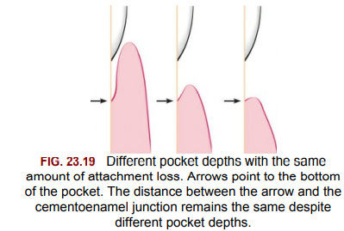
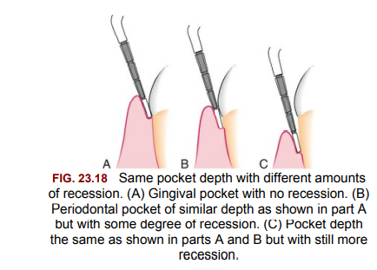
Pockets of the same depth may be associated with different degrees of attachment loss, and pockets of different depths may be associated with the same amount of attachment loss.
Extensive attachment and bone loss may be associated with shallow pockets if the attachment loss is accompanied by recession of the gingival margin, and slight bone loss can occur with deep pockets.

Slide 75
AREA BETWEEN BASE OF POCKET AND ALVEOLAR BONE
Normally, the distance between the apical end of the junctional epithelium and the alveolar bone is relatively constant.
The distance between the apical extent of calculus and the alveolar crest in human periodontal pockets is most constant, having a mean length of 1.97 mm (±33.16%).
The distance from attached plaque to bone is never less than 0.5 mm and never more than 2.7 mm.
These findings suggest that the bone-resorbing activity induced by the bacteria is exerted within these distances.
However, the finding of isolated bacteria or clumps of bacteria in the connective tissue and on the bone surface may modify these considerations.

Slide 76
RELATIONSHIP OF POCKET TO BONE
In infrabony pockets, the base of the pocket is apical to the crest of the alveolar bone, and the pocket wall lies between the tooth and the bone.
The bone loss is in most cases vertical. Alternatively, in suprabony pockets, the base is coronal to the crest of the alveolar bone, and the pocket wall lies coronal to the bone.
The type of bone loss is always horizontal. This creates some microscopic differences that have some therapeutic importance.
They are the relationship of the soft-tissue wall of the pocket to the alveolar bone, the pattern of bone destruction, and the direction of the transseptal fibers of the periodontal ligament.

Slide 77
In suprabony pockets, the alveolar crest gradually attains a more apical position in relation to the tooth, but it retains its general morphology and architecture.
The interdental fibers that run over the bone from one tooth to the other maintain their usual horizontal direction.
In infrabony pockets, the morphology of the alveolar crest changes completely, with the formation of an angular bony defect.
The interdental fibers in this case run over the bone in an oblique direction between the two teeth of the interdental space. This may affect the function of the area and also necessitate a modification in treatment techniques.

Slide 78
DISTINGUISHING FEATURES OF SUPRABONY AND INTRABONY PERIODONTAL POCKETS
Suprabony pocket | Intrabony pocket
1. The base of the pocket is coronal to the level of the alveolar bone. | 1. The base of the pocket is apical to the crest of the alveolar bone so that the bone is adjacent to the soft-tissue wall.
2. The pattern of destruction of the underlying bone is horizontal. | 2. The pattern of bone destruction is vertical (angular).
3. Interproximally, transseptal fibers that are restored during progressive periodontal disease are arranged horizontally in the space between the base of the pocket and the alveolar bone. | 3. Interproximally, transseptal fibers are oblique rather than horizontal. They extend from the cementum beneath the base of the pocket along the alveolar bone and over the crest to the cementum of the adjacent tooth.
4. On the facial and lingual surfaces, periodontal ligament fibers beneath the pocket follow their normal horizontal– oblique course between the tooth and the bone. | 4. On the facial and lingual surfaces, periodontal ligament fibers follow the angular pattern of the adjacent bone. They extend from the cementum beneath the base of the pocket along the alveolar bone and over the crest to join with the outer periosteum.

Slide 79
Pocket reduction surgeries
Pocket reduction surgeries are aimed at reducing the probing pocket depths in patients with periodontitis.
Depending on the disease presentation, one can take a resective or regenerative approach. Suprabony pockets are primarily treated by resective procedures such as gingivectomy or osseous surgery, whereas infrabony defects with multiple walls (that are contained) are generally treated using regenerative approaches.

Slide 80
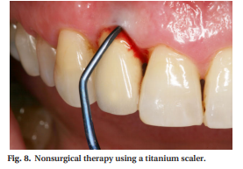
Treatment of peri-implant pockets diagnosed with peri-implant mucositis
Current evidence indicates that peri-implant mucositis is the precursor of peri-implantitis in the same way that gingivitis is the precursor of periodontitis.
We now have enough evidence to suggest that peri-implant mucositis, like gingivitis, is reversible when effectively treated with the indicated therapeutic regimens.
When inflammation is identified around the implant head, mechanical therapy, with or without adjunctive use of antiseptic rinses, is usually employed as the treatment of choice.
For effective mechanical debridement of the implant surface, specially designed hand instruments have been developed and are made of pure titanium or ceramics.

Slide 81
Their design helps in reducing the damage to implant surfaces and in achieving efficient plaque removal.
The combination of professional irrigation of the sulci with chlorhexidine and professional administration of local delivery antimicrobials as an adjunct to mechanical therapy did not show any advantage over mechanical therapy alone in the treatment of periimplant mucositis.
In a study by Schenk et al., little effect was observed from the submucosal placement of tetracycline fibers. However, the standard of oral hygiene was low in this study, which makes it difficult to reach firm conclusions.

Slide 82
In a study by Felo et al., patients with moderate mucositis and shallow probing depths were used to compare two different regimes for the treatment of peri-implant mucositis.
Self-administration of chlorhexidine irrigation was shown to be significantly more effective in reducing signs of peri-implant mucositis compared with rinsing alone with chlorhexidine.
Additionally, less staining and less calculus was observed in patients who used irrigation as the mode of therapy.
Finally, the use of phosphoric acid as an adjunct to mechanical maintenance therapy was evaluated and some advantages were reported.

Slide 83
Treatment of peri-implant pockets diagnosed with peri-implantitis
Nonsurgical therapy
The peri-implant pocket becomes deeper as the disease progresses and the bone resorbs.
This increased probing depth, in combination with the surface structure of the implant’s screw design and the supra-structure, may hinder effective nonsurgical debridement of the infected implant.
Nevertheless, nonsurgical therapy should always be performed before any surgical intervention as this gives time for evaluating the healing response of the tissues as well as the patient’s ability to perform effective oral hygiene measures.

Slide 84
As demonstrated in a study by Renvert et al., there is always the possibility that the nonsurgical therapy will resolve the problem without any further surgical intervention being necessary.
In most of the studies conducted over the last few years, nonsurgical therapy was performed using specially designed scalers or ultrasonic devices with plastic- or Teflon-coated tips. These instruments were designed with the aim of reducing damage to the implant surface.
Current evidence suggests that using these instruments to decontaminate between the treads, within the irregularities of modern implants is rather ineffective.

Slide 85
In a study by Karring et al., only minor changes in bleeding tendency were observed 6 months following therapy with either the Vector system using a carbon-fiber tip or a manual carbon-fiber curette, and probing depths either did not improve or became deeper.
Similar results were obtained from a randomized controlled trial comparing the use of either titanium curettes or an ultrasonic device designed for implants.
Although significant reduction in bleeding tendency and plaque scores was noted after 6 months, probing depths did not improve.

Slide 86
Laser therapy has also been suggested as a nonsurgical approach for decontaminating the implant surfaces deep in the peri-implant pocket.
The use of Er:YAG lasers could offer an advantage over traditional mechanical treatment as they have a bactericidal effect.
Better clinical results have been reported using laser treatment compared with traditional mechanical debridement.
Earlier studies demonstrated that decontamination using nonsurgical photodynamic therapy (diode soft laser and dye) can effectively reduce the levels of certain bacteria, such as A. actinomycetemcomitans, P. gingivalis and P. intermedia but cannot eliminate them completely.
In a clinical evaluation comparing an Er:YAG laser and the air-abrasive PERIO-FLOW for the treatment of advanced peri-implantitis, the results demonstrated similar reductions in probing pocket depths, frequency of suppuration and bleeding at implants.

Slide 87
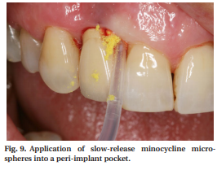
A number of different local antimicrobials, such as tetracycline-containing fibers, a slow-release doxycycline-containing gel or minocycline microspheres, have been used over the years.
The adjunctive use of a slow-release doxycycline-containing preparation was evaluated in a controlled study in which the supra-structure was removed before nonsurgical therapy, including mechanical cleaning and irrigation with 0.2% chlorhexidine.
It was concluded that the local application of this antimicrobial significantly improved the results.

Slide 88
Surgical treatment
Mechanical nonsurgical therapy alone is insufficient in majority of advanced periimplantitis lesions and in such cases a surgical approach is indicated.
The major objective here, is to provide access for removal of the biofilm and calcified deposits from the implant surface in order to allow healing and reduce the risk for further disease progression.
The decision of whether to use a resective or a regenerative surgical technique depends on the clinical situation.

Slide 89
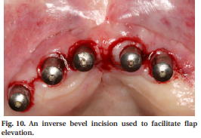
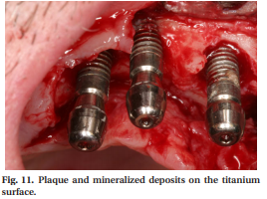
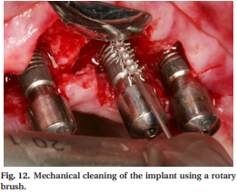
When surgical intervention is necessary, an inverse bevel incision is recommended to facilitate flap elevation and preserve soft tissue.
Following removal of the soft-tissue collar from the infected tissue around the implant, mechanical decontamination to remove plaque and mineralized deposits from the implant surface should be performed and, for this task, instruments made of pure titanium are recommended.
The use of a titanium rotary brush makes this procedure easier than use of conventional curettes.

Slide 90
Airborne-particle abrasion devices have also been recommended for the decontamination of implant surfaces during surgery but because of the risk of developing subcutaneous emphysema, care must be taken during their use.
Other methods for decontamination, such as the use of lasers or abrasive devices, and implantoplasty of the exposed part of the implant, have been suggested as adjuncts to surgical resective or regenerative surgery but the clinical improvements reported when using these techniques are limited and the evidence is weak.
In general, mechanical decontamination should be followed by application of chemical agents onto the exposed surface of the affected implants.

Slide 91
In this respect, the substances that have been recommended are hydrogen peroxide, citric acid, sodium chloride, chloramines, tetracycline hydrochloride and chlorhexidine gluconate.
From the evidence available, no single method has been proven superior. Owing to its availability, efficiency and safety, hydrogen peroxide applied on the implant surface for 2 min has been the substance most widely used for chemical decontamination.
However, irrespective of the agent used, the implant and the peri-implant wound area should be thoroughly rinsed with a sterile solution following decontamination.

Slide 92
Clinical decisions regarding the most suitable surgical approach are usually made depending on the position of the affected implant.
In nonesthetic areas, where exposure of the titanium components is not a major complication, resective surgery and apical positioning of the flap are preferable in order to reduce the pocket depth and improve access for home care.
In esthetic areas, the decision for the appropriate intervention is usually based on the morphology of the defect and the degree of bone loss.

Slide 93
Radiographic and clinical examinations may provide an indication of the morphology of the bony defect but are not sensitive enough to give us the complete picture. This can only be determined following elevation of the flap and removal of the granulation tissue.
In the presence of a crater-like four wall bony defect or a three-wall defect, regenerative techniques are recommended and the use of autogenous bone or bone substitutes can be used to obtain bone fill.
A resorbable membrane can also be used in combination with the above-mentioned grafting materials.

Slide 94
For two-wall defects, regenerative procedures are usually not indicated as the morphology of the alveolar bone does not allow the grafting material to be properly maintained in the required area.
Several studies have investigated the effect of grafting materials as well as the effect of the combination of barrier membranes and grafting materials on treatment success.
Based on the results of these studies, the use of these barrier membranes does not seem to improve the healing process and often results in postoperative complications as a result of membrane exposure.

Slide 95
A recent randomized controlled clinical trial investigated the difference in healing between subjects receiving antibiotics, surgical debridement and either autogenous bone or bovine-derived xenograft covered by a resorbable collagen membrane.
Twenty-two subjects were included in the autogenous bone group and 23 subjects in the bovine-derived xenograft group. Following 12 months of healing, significantly better results were obtained in the bovine-derived xenograft group for bone levels, bleeding on probing and suppuration, but the success for both procedures was limited.
It has been suggested in the past that the stability of the membrane can influence the success of guided tissue regeneration, especially in areas where the bony morphology is unfavorable.

Slide 96
Often, the clinicians come across the presence of a bony dehiscence where the morphology of this defect might not allow for retention of the augmentation material .
In cases like these, it is recommended to use micropins to stabilize the membrane, which in turn will keep the grafting material in place. These micropins can be removed at a later stage.
As in most cases the primary treatment objective is bone regeneration, having enough soft-tissue coverage of the surgical site can significantly increase the success of the regenerative procedures.
In cases where the peri-implant mucosa is thin, additional surgery is indicated before grafting to increase the amount of keratinized tissue.

Slide 97
Self-performed direct biofilm management of pockets
It seems logical that, when pockets are present, they should be regularly cleaned by the patient.
However, while toothbrushing represents the most common oral hygiene method in developed countries, the subgingival effect is very limited.
Studies from the 1970s show that brushing using two different techniques (Roll and Bass) was unable to introduce experimental particles into the crevicular epithelium or underlying connective tissue in patients with periodontal disease.

Slide 98
However, when irrigating devices were used in the same experiment, carbon particles could be detected in the crevicular tissue.
Very limited penetration of the toothbrush, to as far as 0.9 mm below the gingival margin – even when employing the Bass method – was confirmed by Waerhaug.

Slide 99
Antiseptic rinses to control sub-gingival biofilm
Antimicrobial agents can be used to support mechanical biofilm management. Whilst they can be directly applied subgingivally, their effect on subgingival biofilm has major restrictions, such as:
subgingival biofilm, which consists of adherent and floating bacteria, harbors more anaerobes than supragingival biofilm;
in periodontal pockets it is more difficult for antibacterial agents to reach their target site and/or to sustain a concentration high enough to affect the biofilm;

Slide 100
gingival crevicular fluid flow increases with clinical signs of inflammation and washes out antibacterial agents within a short period of time, thus limiting their subgingival effect; and
in periodontal pockets, antibacterial agents can be inactivated (e.g. by serum proteins) – this is especially true for chlorhexidine.
Although chlorhexidine is currently the most efficient anti-plaque and anti-gingivitis agent available and is generally accepted as the gold standard, it has been shown to be inactivated by blood and serum.
Therefore, the effects of chlorhexidine observed in the supragingival environment cannot simply be extrapolated to the subgingival milieu.

Slide 101
REFERENCES
Carranza’s Clinical Periodontology – 13th Edition.
Niklaus P. Lang, Jan Lindhe; Clinical Periodontology and Implant Dentistry – 6th Edition.
Bosshardt DD; The periodontal pocket: pathogenesis, histopathology and consequences. Perio 2000, Vol. 0, 2017, 1-8.
Mombelli A; Microbial colonization of the periodontal pocket and its significance for periodontal therapy. Perio 2000, Vol 0, 2017, 1-12.

Slide 102
Arweiler NB, Auschill TM, Sculean A; Patient self-care of periodontal pocket infections. Perio 2000, Vol 0, 2017, 1-16.
Renvert S, Polyzois I; Treatment of pathologic peri-implant pockets. Perio 2000, Vol 0, 2017, 1-11.
Ko, T.-J.; Byrd, K.M.; Kim, S.A. The Chairside Periodontal Diagnostic Toolkit: Past, Present, and Future. Diagnostics 2021, 11, 932.
Ramachandra, S.S.; Mehta, D.S.; Sandesh, N.; Baliga, V.; Amarnath, J. Periodontal probing systems: A review of available equipment. Compend. Contin. Educ. Dent. 2011, 32, 71–77.

